Slide 1


Department of Artificial Intelligence and Data Science
Telecommunications: SIM/Identity Fraud Detection using Big Data and AI
Mr.SUBRAMANIAN ASST.PROFESSOR
GIRIDHARAN R-231801040 JAGADEESAN T -231801062 GOWTHAM RAJ S -231801045

Slide 2
Problem Statement and Motivation
Telecommunication networks face increasing fraud activities such as SIM swap, identity theft, and fake KYC registrations.
These frauds cause financial losses, data breaches, and erosion of customer trust.
Conventional rule-based systems fail to detect new or adaptive fraud patterns and often generate false positives.
Hence, there is a need for an AI-driven fraud detection system capable of real-time monitoring, anomaly detection, and automated alerting.

Slide 3
Objectives
• Analyse SIM registration and usage data to identify anomalies linked to fraud.
• Develop a machine learning pipeline for detecting SIM swap and identity-based fraud.
• Ensure real-time fraud alerts to telecom operators.
• Reduce false positives by combining behavioural, transactional, and network data.
• Enable scalable, explainable, and privacy-preserving fraud analytics.

Slide 4
Existing System
S.No | Model / Technique Used | Author(s) | Description | Outcome / Limitation
1 | Rule-Based Systems | Telecom Operators | Use predefined rules and thresholds to flag suspicious activity. | Misses new or evolving fraud schemes.
2 | Statistical Profiling | S. Kim et al. | Uses average usage profiles to detect deviations. | Ineffective for dynamic fraud behaviors.
3 | Blacklist Matching | GSMA Reports | Identifies fraud via known fraudulent numbers or IMEIs. | Only detects known frauds.

Slide 5
Abstract
Telecommunication networks are vulnerable to SIM and identity frauds involving fake registrations, SIM swaps, and unauthorized user impersonation.
This project proposes a Big Data–driven AI system for real-time detection of telecom identity frauds.
Using data from call records, KYC information, and usage patterns, ML models detect suspicious activities and trigger alerts.
The system leverages Spark for distributed data processing and ML models for anomaly detection, providing high scalability and precision.

Slide 6
Literature Survey
S.no | Title | Author(s) | Year | Methodology | Dataset | Key Findings
1 | Machine Learning Approaches for Telecom Fraud Detection | IEEE Researchers | 2021 | Random Forest, Logistic Regression, Neural Networks | Telecom CDR dataset (synthetic + real) | ML models outperform rule-based systems by ~30% in detection accuracy.
2 | Graph-based Analysis for SIM Fraud | Elsevier Journal | 2022 | Graph Neural Networks (GNN) | SIM linkage graph data from telecom network | Identifies collusive SIM groups with 95% precision.

Slide 7
Literature Survey
S.no | Title | Author(s) | Year | Methodology | Dataset | Key Findings
3 | Big Data Framework for Telecom Fraud Analytics | Springer Authors | 2020 | Hadoop + Spark pipeline for fraud analytics | Call Detail Records (10M+ entries) | Reduced detection time by 40% through distributed processing.
4 | Behavioral Anomaly Detection in Cellular Networks | ACM Conference Paper | 2021 | LSTM and Autoencoder models | Mobile user behavioral logs | Captures temporal anomalies in SIM usage patterns.
Department of Artificial Intelligence and Data
Science
7
Zeroth Review

Slide 8
Literature Survey
S.no | Title | Author(s) | Year | Methodology | Dataset | Key Findings
5 | Hybrid Fraud Detection using AI and Rule Systems | IEEE Access | 2023 | Ensemble of rule-based + ML classifiers | Telecom operator KYC + usage data | Achieved 92% accuracy and improved explainability.
6 | Unsupervised Anomaly Detection in SIM Card Activity | MDPI Sensors | 2022 | Isolation Forest, DBSCAN | Network event logs (SIM swaps & location data) | Detected unknown fraud patterns without labeled data.
Zeroth Review

Slide 9
Literature Survey
S.no | Title | Author(s) | Year | Methodology | Dataset | Key Findings
7 | Deep Graph Learning for Telecom Fraud Detection | Elsevier Neural Networks | 2023 | Graph Convolutional Networks (GCN) | Graph data of users, devices, and transactions | Enhanced relational fraud detection with fewer false positives.
8 | AI-Driven Fraud Prevention in Mobile Identity Verification | IEEE Transactions on AI | 2024 | Federated Learning + Deep Neural Networks | Cross-operator KYC + verification datasets | Privacy-preserving model achieving 89% detection
Zeroth Review

Slide 10
Literature Survey
S.no | Title | Author(s) | Year | Methodology | Dataset | Key Findings
9 | Blockchain-based Secure SIM Identity Management | Springer Blockchain Series | 2023 | Smart Contract-based Identity Verification | Simulated blockchain registry data | Prevented SIM cloning and identity tampering using immutable records.
10 | Explainable AI for Telecom Fraud Detection | Wiley Expert Systems | 2024 | SHAP + XGBoost models | Real telecom operator fraud logs | Provided interpretable fraud decisions improving analyst trust and transparency.
Zeroth Review

Slide 11
INTRODUCTION (SRS)
Title: Telecom SIM/Identity Fraud Detection using Big Data and AI
Purpose:
• Identify and prevent fraudulent SIM activations.
• Detect SIM swaps, cloned devices, and fake KYC.
• Alert authorities instantly upon suspicious activity.
Scope:
• Phase 1: Prototype with Spark, Python, ML models.
• Phase 2: Cloud deployment with dashboards and alerts.
Users:
Telecom operators, fraud analysts, regulatory bodies.

Slide 12
OVERALL DESCRIPTION
System Layers:
• Data Ingestion – CDRs, KYC details, metadata via Kafka/HDFS.
• Processing Layer – Apache Spark + ML models.
• Dashboard – Visualization and alerts.
Features:
• Real-time detection
• Graph-based linking
• Cloud scalability

Slide 13
SYSTEM FEATURES
• Data Collection: Gather SIM registration and usage data.
• Feature Engineering: Extract behavioral metrics.
• Model Training: Train ML models for fraud detection.
• Fraud Alerting: Real-time notification to analysts.
• Visualization: Dashboard for fraud trends.
• Audit Log: Stores detection history.

Slide 14
ALGORITHMS
Fraud Detection:
• Machine Learning – Random Forest, XGBoost, Isolation Forest.
• Deep Learning – LSTM for sequential anomaly detection.
• Graph-based – Detect colluding SIMs via connected patterns.
Steps:
1. Preprocess data.
2. Train on labelled datasets.
3. Classify new transactions.
4. Generate fraud risk scores.

Slide 15
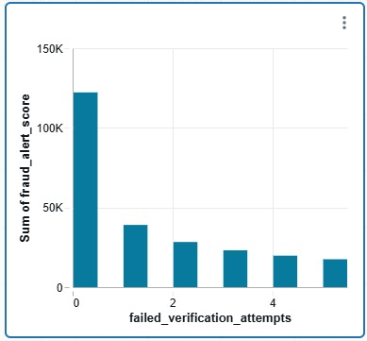
VISUALIZATION-HISTOGRAM

Slide 16
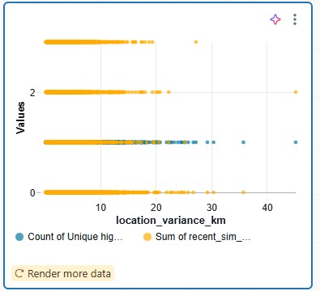
VISUALIZATION-SCATTER PLOT

Slide 17
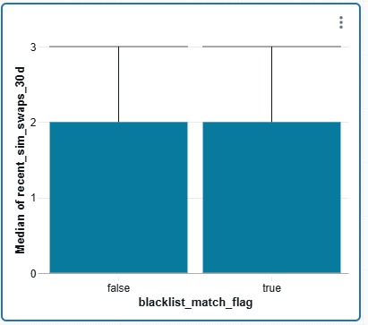
VISUALIZATION-BOX PLOT

Slide 18
EXTERNAL INTERFACES
Alert System:
• Dashboard, SMS, or email alerts to fraud teams.
• REST API for integration with CRM and KYC systems.
Scalability & Storage:
• Big Data (Hadoop + Spark)
• Cloud storage for CDR data and model logs.

Slide 19
SYSTEM REQUIREMENTS
Hardware:
• Minimum: 8 GB RAM, Dual-core CPU.
• Recommended: 16 GB RAM, Quad-core CPU, SSD.
Software:
• OS: Linux/Windows
• Python 3.10+, Spark, Kafka, HDFS, Flask
• ML: scikit-learn, TensorFlow/PyTorch
• DB: PostgreSQL / MongoDB

Slide 20
NON FUNCTIONAL REQUIREMENTS
• Performance: Detect frauds within 1 sec.
• Security: Encrypt user and KYC data.
• Scalability: Handle millions of SIM records.
• Portability: Works on on-premise/cloud.
• Maintainability: Modular ML pipeline.

Slide 21
FUTURE SCOPE
• Integrate with national KYC systems.
• Federated learning for privacy-preserving training.
• Explainable AI dashboards.
• Detect subscription and roaming frauds.
• Active learning from analyst feedback.

Slide 22
Thank You

